Slide 1


PIZZA SALES

Slide 2
Hello everyone!
I recently completed a project on pizza sales using SQL. Working with a provided dataset, I analyzed sales patterns and customer preferences to uncover insights and improve sales strategies. Thank you!

Slide 3
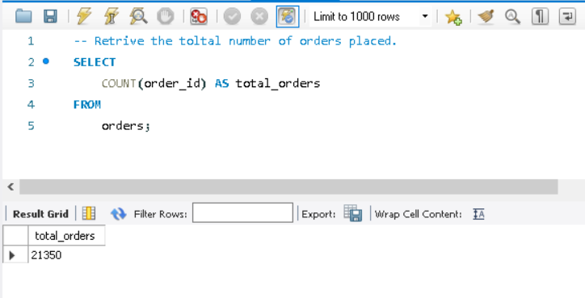
Retrive the total number of orders placed.
Shrub

Slide 4
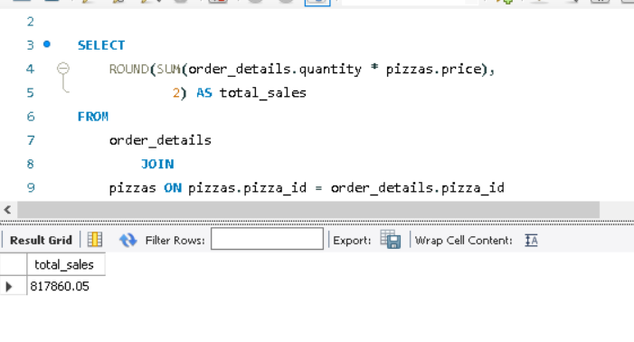
Calculate the total revenue generated from pizza sales.

Slide 5
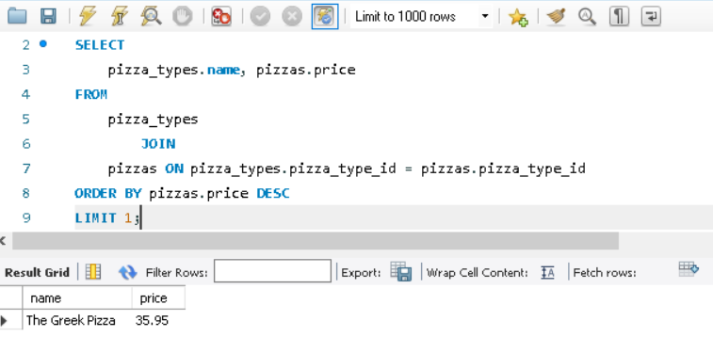
Identify the highest-priced pizza.

Slide 6
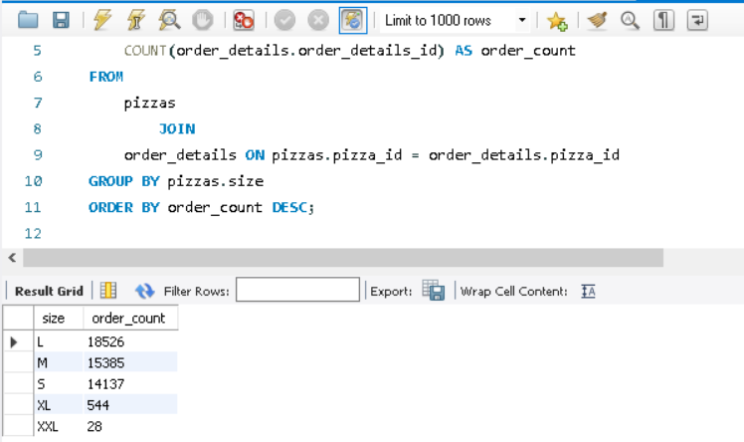
Identify the most common pizza size ordered.

Slide 7
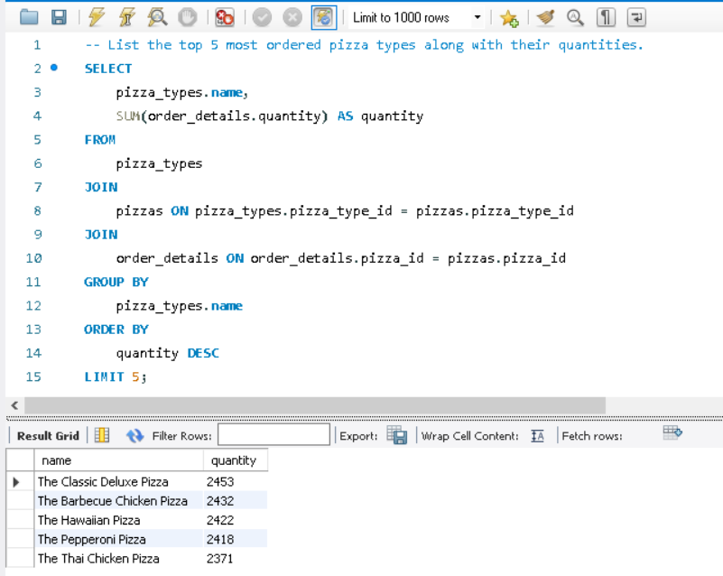
List the top 5 most ordered pizza types along with their quantities.

Slide 8
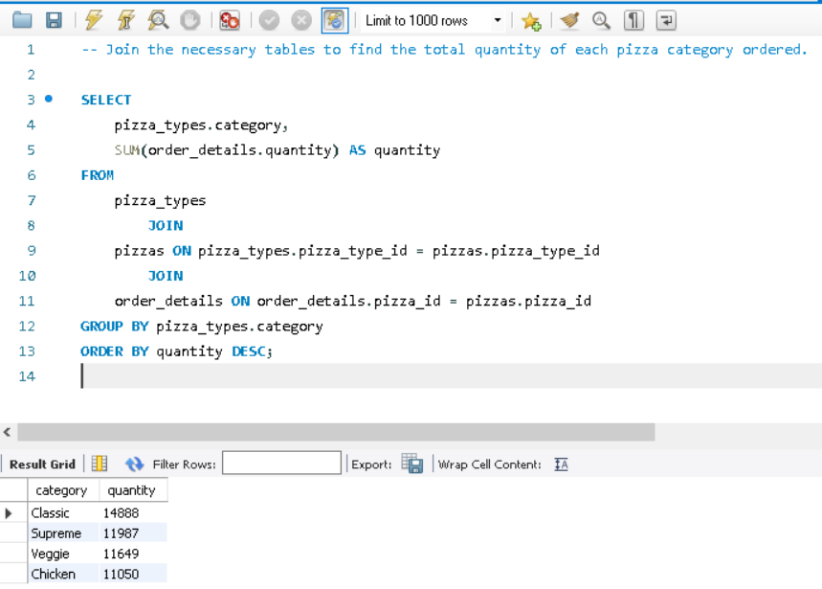
Join the necessary tables to find the total quantity of each pizza category ordered.

Slide 9
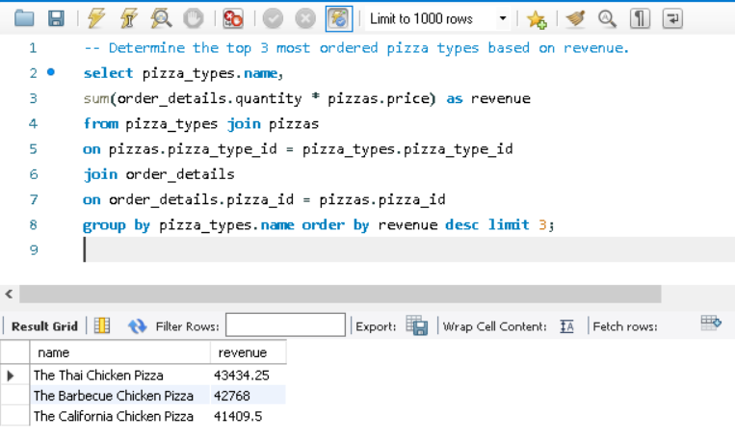
Determine the top 3 most ordered pizza types based on revenue.

Slide 10
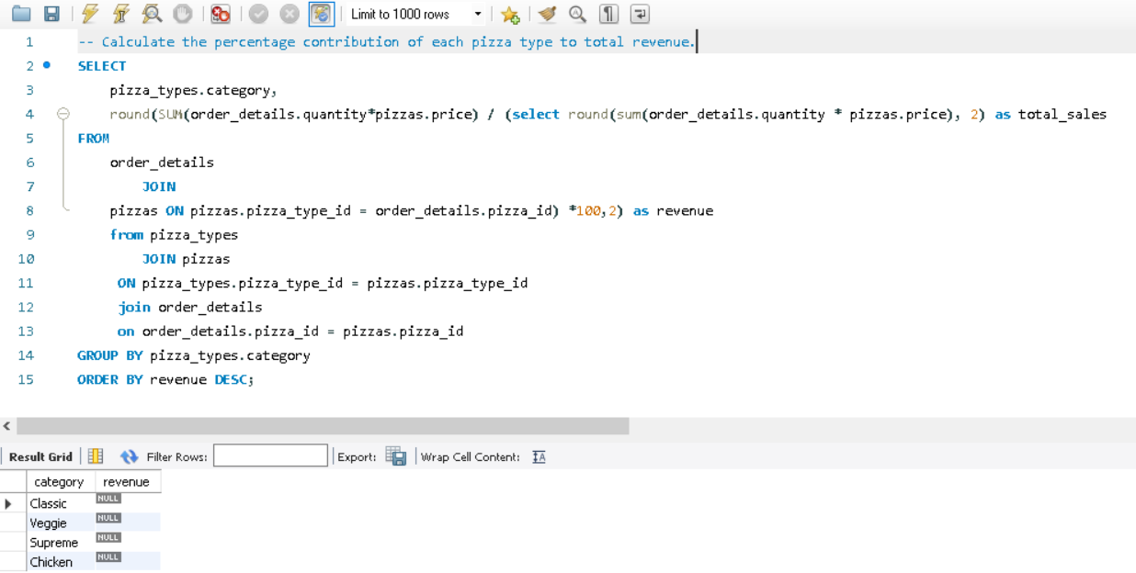
Calculate the percentage contribution of each pizza type to total revenue.

Slide 11
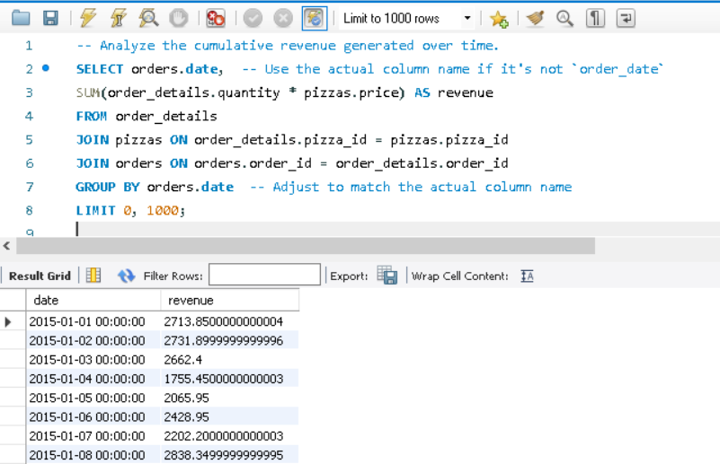
Analyze the cumulative revenue generated over time.

Slide 12
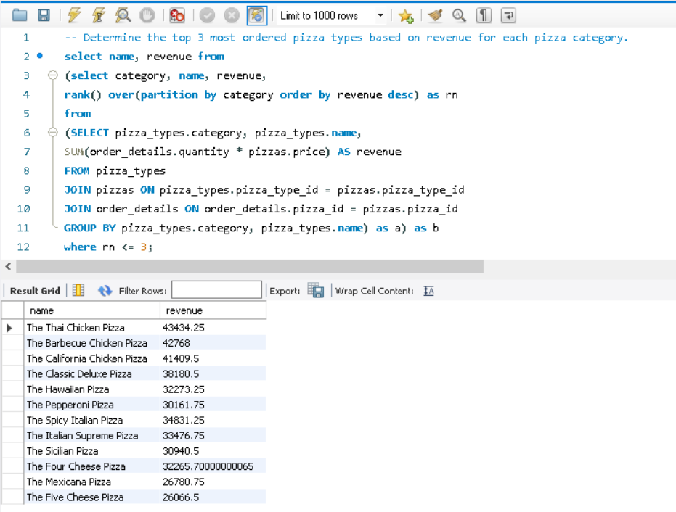
Determine the top 3 most ordered pizza types based on revenue for each pizza category.

